Slide 1


New Approach of ILS System Using Galileo/GPS Space Navigation in NATO Information Infrastructure
(Risk Analysis Case Study)
Doctoral School of Military Engineering(DSME)/ Defense Electronic ICT
National University of Public Services(NUPS)
NEMZETI KÖZSZOLGÁLATI EGYETEM (NKE)
Budapest – Hungary
Communication Conference 2019
Gen. Prof. Dr. Laszlo KOVACS
Department of Electronic Warfare
Supervisor: Capt. Dr. Habil. Tibor Farkas
Department of Communication
Col(r). Eng. Ahmad Alhosban, (14th Nov. 2019)

Slide 2
Contents
Is GPS space navigation considered as CI?
Techniques/Regulations used to protect GPS assets/services
GBAS: Ground Based Augmentation System : ILS Landing System Infrastructure
GBAS Proposed Risk Model and Probability of Hazard /Parameters Assumptions
Case study And Analysis: increasing resilience, security and Availability of GPS GBAS ILS stations
Findings and Recommendations

Slide 3
Aim and Objectives
The Aim of this study is to shed the light on the following :
To Identify GPS space navigation systems as a Critical Infrastructure especially GBAS ILS systems
To Identify What are the Techniques/Regulations used to protect GPS assets/services and by which Agencies in Both USA and NATO.
To Analysis How to increase resilience and security of GPS GBAS ILS stations proposed Hungary including Liszt Ferenc (BUD) AirPort Against potential Threats.
Final results and recommendations.

Slide 4
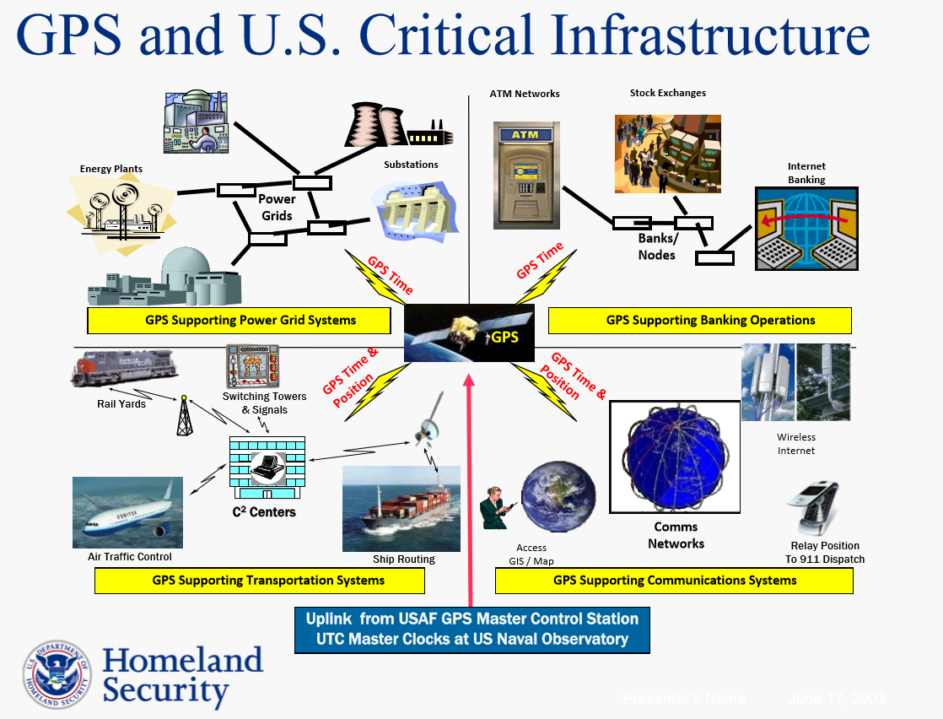
Is GPS space navigation systems considered as CI?
Information and Communication is one of the (Ted, CIP in HS, 2015):
CI sectors (8) defined by PDD-63 (1998)/ by DHS USA: AND CIKR as defined by PPD-21 (2013) /by DHS:
Banking and finance
Emergency law enforcement services
Emergency services
Energy
Information and communications
Public health services
Transportation
Water supply
Positioning, Navigation, Timing (PNT)

Slide 5
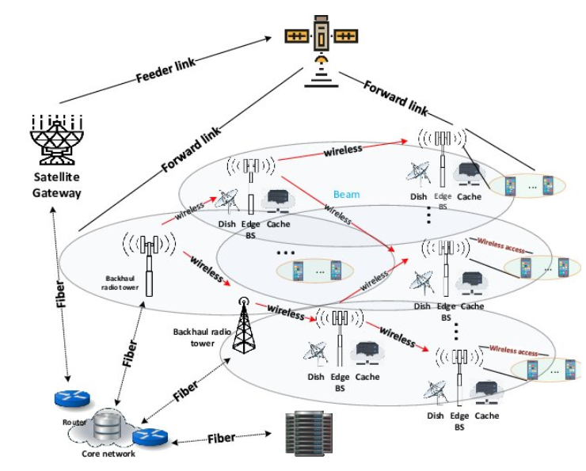
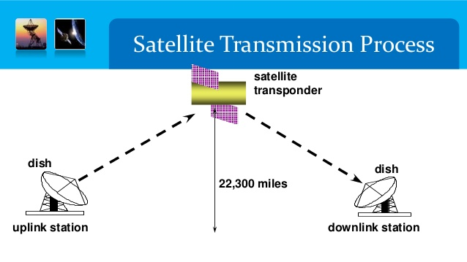
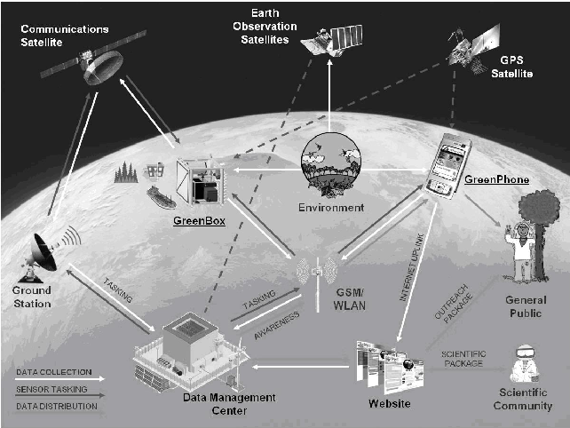
Do SATCOM/SATNAV became a part of Info. Com. Infrastructure?
SV
GS
Hybrid satellite-terrestrial network using a multi-beam satellite for more accurate content placement phase
https://www.researchgate.net/publication/322517217_Cache-Assisted_Hybrid_Satellite-Terrestrial_Backhauling_for_5G_Cellular_Networks/figures?lo=1

Slide 6

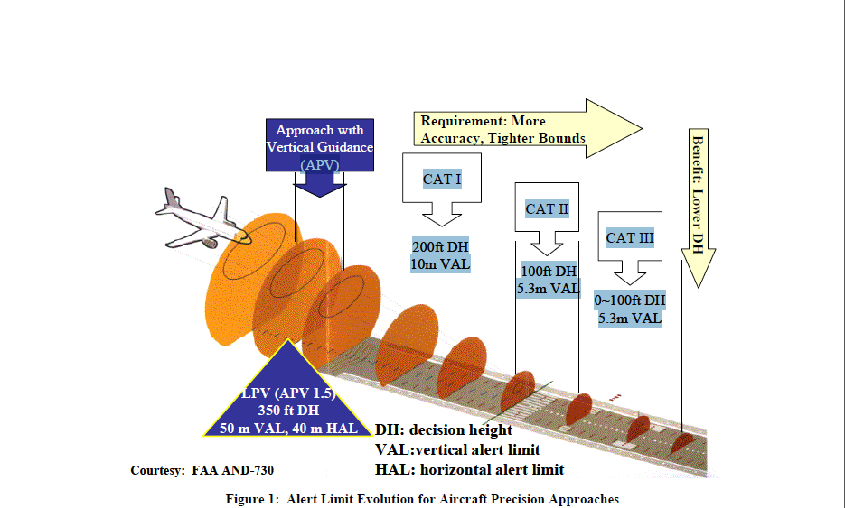
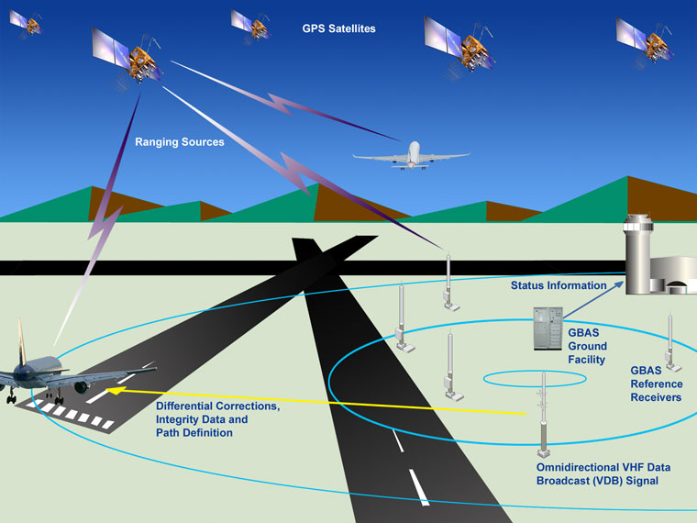
GBAS: Ground Based Augmentation System : ILS Landing System Infrastructure
GBAS Advantages over ILS:
A single installation at a major airport can be used for multiple precision approaches within the local area. Chicago O'Hare has 12 runway ends each with a separate ILS. all 12 ILS facilities can be replaced with a single GBAS system.
Unlike ILS — which requires one frequency per system — a GBAS only requires one VHF assignment for up to 48 individual approach procedures.
The potential for approaches that are not straight- in. curved or complex approaches to avoid obstacles or to decrease noise levels in areas surrounding an airport.
More Safety for passengers/More Capacity

Slide 7
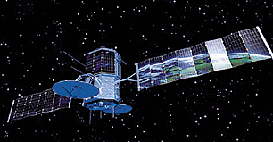

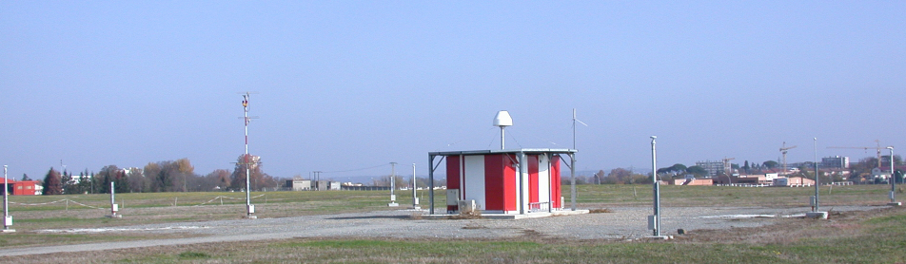
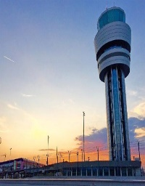
WP1: GNSS Local Element :Operation Principle
Techniques/Regulations used to protect GPS assets/services
Regulations:
ICAO Annex 10
EUROCAE DO
RTCA DO245
MOPS ED-114
SAGA DO20
GNSS Constellation
GNSS Constellation
Space Segment
Link 2: Sat to User(L1)
Techniques:
Redundancy
OR Gates/AND Gates Logic
Monitoring
No. of SATs in sky view
Hybridization with other systems
Differential GPS
Dual System GPS/Galileo
Dual Frequencies L1/L2
BOC ant- jamming
Sitting criteria
Multipath Antennas
Link 1: Sat to GS(L1)
Approval Path definition Data
Aircraft(User)
User Segment
Ground Reference Station (GS)
Link 3: GS to User (VHF)
VDB
* Provide Aircraft with:
Approach path definition data.
Range correction.
Integrity parameters for each sat. in view
Landlines
Link 4: GS to Tower (Landline)
Ground Segment

Slide 8
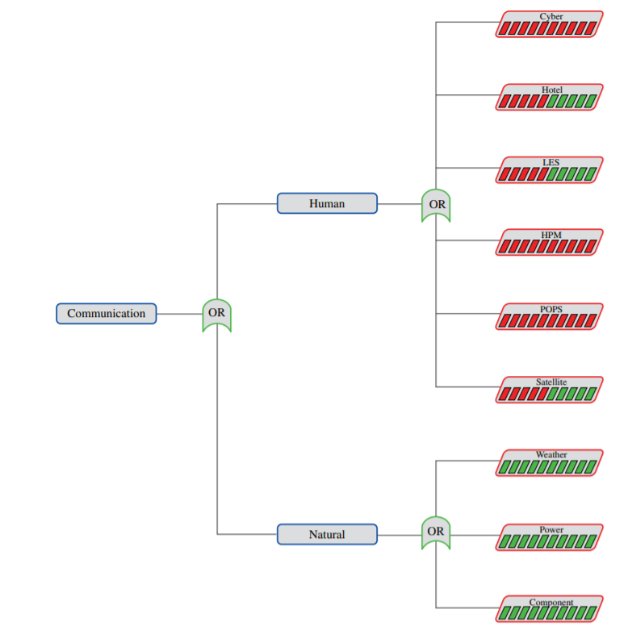
Proposed Risk Model and Probability of Hazard
Satellite Com fault-free Risk Model
OR
Space Segment Risk
User Segment Risk
Ground Segment Risk
Links Risk
Threats: On Ground Seg/User Seg./links:
Malfunctions and Human( cyber and attack)
Threats on Space Seg.: Natural(space)
Human-caused hazard fault tree risk model for the communication sector lists the most likely threats, TED CIP on HMS.

Slide 9
GBAS Proposed Risk Model and Probability of Hazard /Parameters Assumptions
Assumptions:
Zero risk of physical attacks; due to protection of vicinity by Airports authorities.
Cyper attacks risk on GPS L1 link, not guaranteed depending on siting, and measured by multipath techniques in ref .10
Malfunctions and errors risk ; measured as per equations shown beside.
: is the total (post correction) fault free noise term provided by the ground function (via VDB) for satellite i.
: is a term which is computed by the airborne equipment to cover the residual tropospheric error for satellite i.
: is the residual Ionospheric delay (due to spatial decorrelation) uncertainty for the ranging source.
: is the standard deviation of the aircraft contribution to the corrected pseudorange error for the ranging source. The aircraft contribution includes the receiver contribution and standard allowance for airframe multipath.
One of the most extreme environments known to man, full of debris shooting around at hypervelocity, extremes of temperature and exposure to radiation, particles and plasma, this means addition to concrete risks.

Slide 10

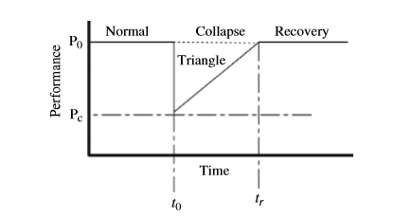
Case study And Analysis: increasing resilience, security and availability of GPS GBAS ILS stations
Monitoring strategies and reliability of GBAS Landing system
A resilience triangle is formed by a collapse followed by recovery
Reducing the size of the resilience triangle increases resilience:
Speed up recovery: (tr − t0)
2. reduce performance drop: (P0 − Pc)
3. Decrease the probability of failure, v
MTTR decreasing on Ground stations,
Nothing to do Space stations, High Reliability.
MTBF increasing on Ground stations and Links, Nothing to do in space stations .

Slide 11

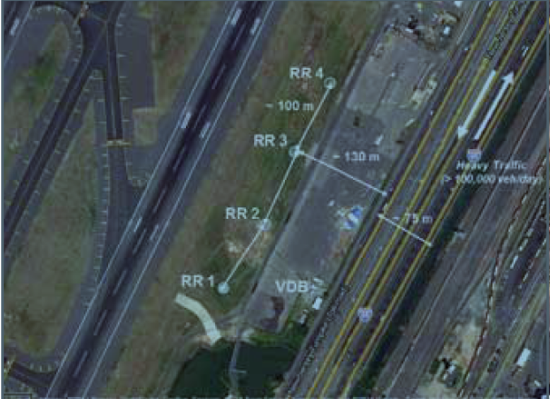
Scientific Problem-Case Study of Newark Airport
Example: GBAS landing system (Honeywell SLS-4000) was not approved by the FAA at Newark Liberty International Airport/USA in 2012 as CAT I (GAST C) due to Jamming the Reference stations, while the certification process was disturbed by a truck jammer driving in a road nearby the airport as per FAA reported, REF [6,7,15]. And also reported in the Future Security Conference -7th in 2012, REF [9, p 197].
Analysis :
Two out of Four Ref. Rx were affected many times per week.
Distance from I-95 road was 130 m, separation bet. Ref. Rxs 100m
Full power jammer cause service lose from only 2 Ref. Rx, but all affected due to AND logic gate output.
Later , software was changed so that any un affected Ref. Rx can do the job. OR GATE Logic so that DGPS concept will work always.
Threat wasn't identified quickly, Poor Monitor Function, (Poor ESM)
Even the MLA Antenna couldn’t prevent the Jamming (Poor EPM)
No human or aircraft lose, GBAS was under certification process.
Suggested solution to increase mask angle to avoid ground interference[15] , which is not all the time the best solution.
More studies are needed to enhance EPMs.

Slide 12

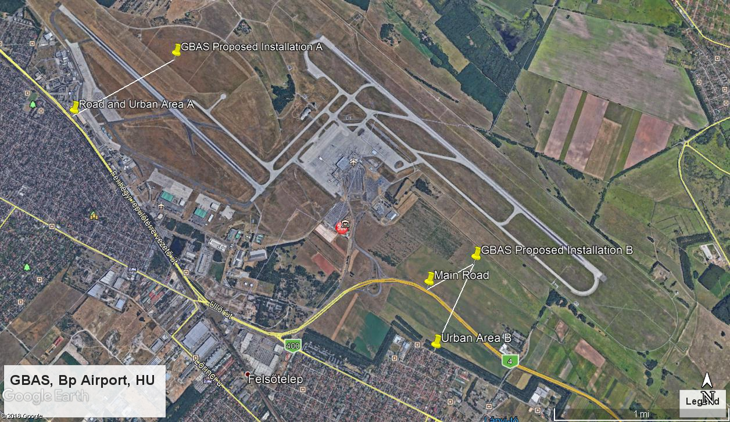
Scientific Problem-Case Study of BUD Airport
BUD Airport Case-Analogy:
Two proposed sites , both are better that Newark Sitting.
The minimum distance from the nearest Road to site is 350m. Which is three times the case of Newark.
Road is not high traffic as Newark case.
GBAS software ESM has changed to better OR Logic selection.
BUD case would be better, especially if Modern GPS and Galileo Fully Operated.(more power, signal structure BOC)
Can Serve 2 runways , 4 ILS, 50Km around, Complex approaches.
1000m
Scientific Problem symptoms
GNSS signals are so vulnerable to EAs because of their extremely low level of power density, about (22,000 Km) arrives at (-160dBw for GPS L1.
Probability of service restore on the proper time is very low. Its high risky in safety-of-life applications of landing systems when compared with other safety –critical infrastructure applications such as banking or non-critical GNSS applications.
GBAS stations are usually located in a well-known surveyed reference sites in the vicinity of the airport near the runways. Which makes them more vulnerable to EAs.
GBAS currently achieving CAT I/GAST C performance only due to errors originally invoked by other than interference or EAs.
350m

Slide 13
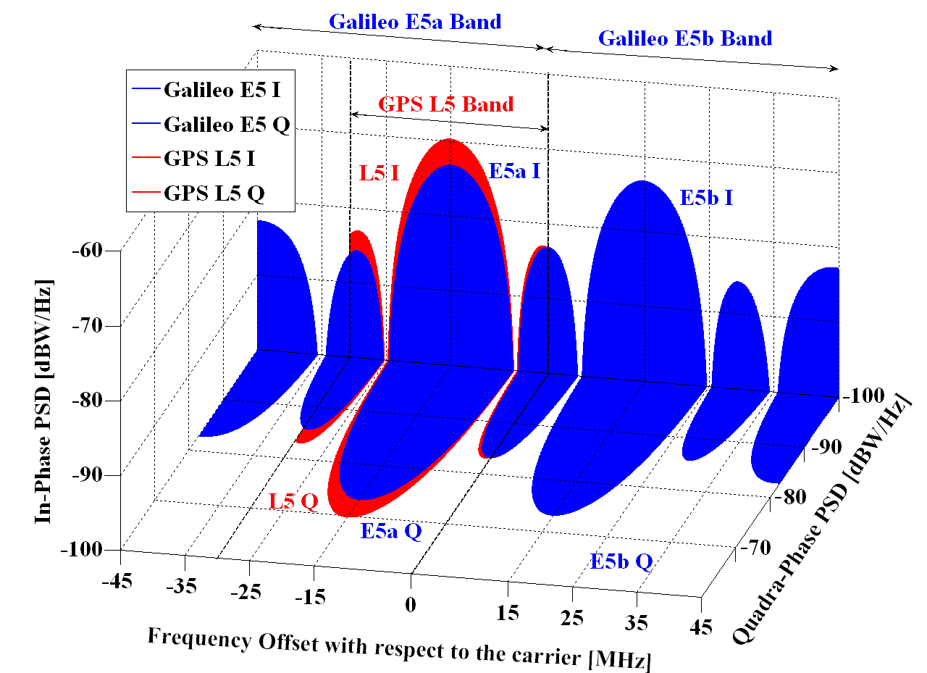
GNSS Improvements
GNSS modernization: 6dB More power , new modulation schemes (BOC)
GPS block IIF/M P/Y code, used currently by US Army , but classified
GPS Block III satellites carrying GPS 2022, Ref [11].
Galileo, new planned signal structure 2022, Ref [12].
New Signal Structure Techniques
Binary Offset Carrier (BOC)
Spreading of the power spectrum
Places a small amount of additional power at a higher frequencies in order to improve the signal tracking performance and as a sequence decreasing the multipath error.[13].
(BPSK) spreads the power with a rectangular pulse shape and spreading code chip rate of 1,023 MHz around the center frequency L1.

Slide 14
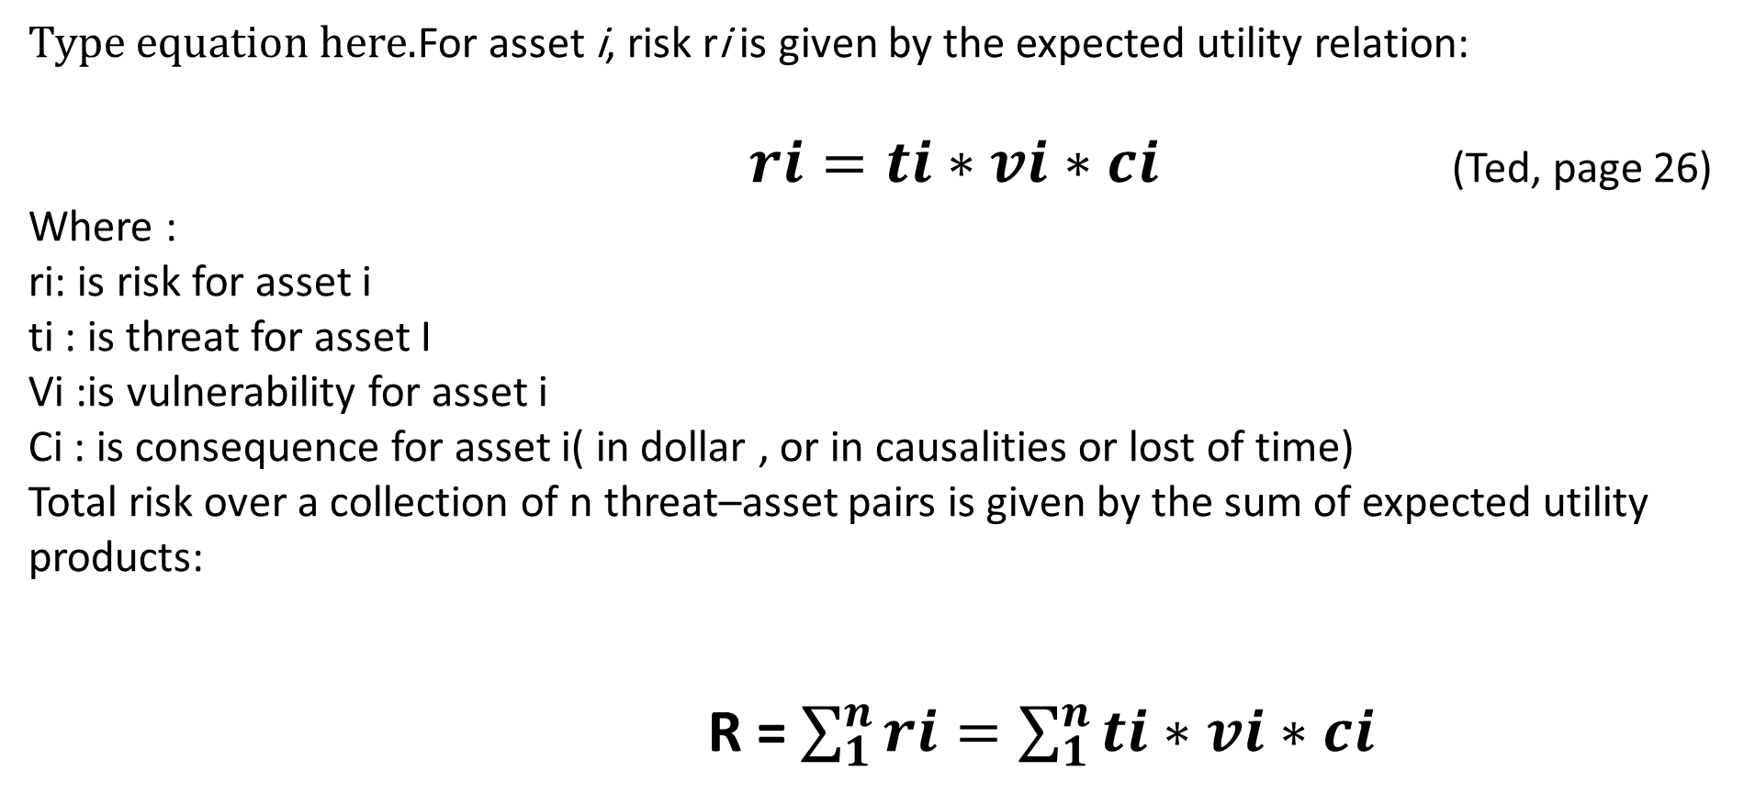
Scientific Problem: Risk –Asset pair Model
For asset i, risk ri is given by the expected utility relation:
$ri=ti∗vi∗ci$ (Ted, page 26)
Where :
ri: is risk for asset i
ti : is threat for asset I
Vi :is vulnerability for asset i
Ci : is consequence for asset i( in dollar , or in causalities or lost of time)
Total risk over a collection of n threat–asset pairs is given by the sum of expected utility products:
R = $\sum_{1}^{n}{ri=\sum_{1}^{n}{ti∗vi∗ci}}$

Slide 15
Scientific Problem: Availability Model
Analogy for GBAS Availability :
Availability = availability of Continuity + Availability of Accuracy + Availability of Integrity
Availability is the probability of resilience and redundancy calculations to meet the ICAO requirements of GBAS performance of Aviation and as per the table below:
Availability = 1- R
Where:
ti : is the jamming / interference measured by multipath fractions.[previous publication]
Vi : is the errors caused by GPS vulnerability given in the equation.
Ci : is the consequences measured by the lost of availability

Slide 16
Scientific Problem-Parameters Assumptions

Slide 17
Availability of GBAS Service
Availability of the GBAS Service
+
+
Availability of Integrity
Availability of Accuracy
Availability of Continuity
VPL_{H0} <= VAL
VEB <= VAL
2xSig _{VERT,H0} <= 95%
PVPL_{H0} <= VAL
These equations are full detailed in the standards

Slide 18
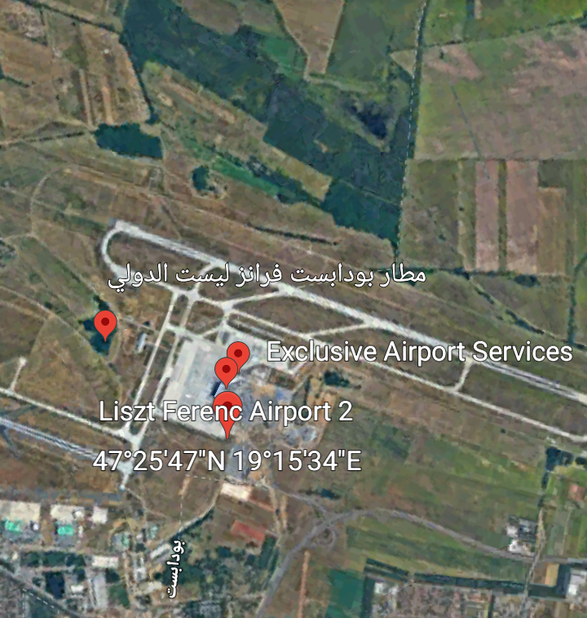
Scientific Problem-Case Study of BUD Airport
USA:65E-127E&23N-50N
EUR:27E-9W&34N-62N

Slide 19
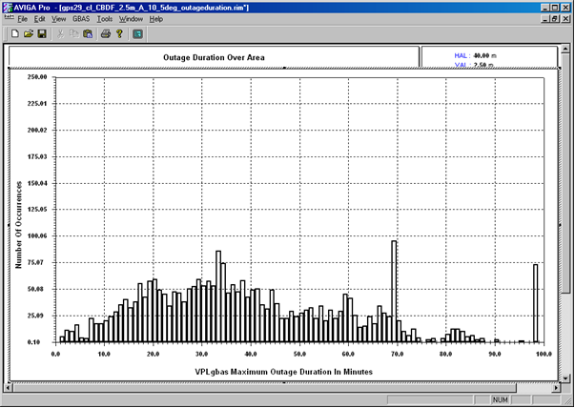
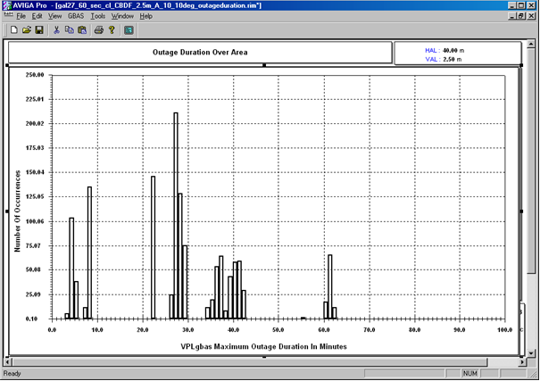
Case Study - Results over Europe: GPS Vs Galileo
Effect of failures , malfunctions, outages
Dense in well distributed areas
Concentrated on specific areas
GPS 29 Outages in 100 minutes -2662
Galileo 27 Outages in 100 minutes -1308
Total number of outages occurrence for Galileo is 1308 occurrences, while in the case of GPS were 2662 occurrences. But in GPS they are so dense in well distributed over the assigned period , while in Galileo they are concentrated on specific points with high values of occurrences

Slide 20
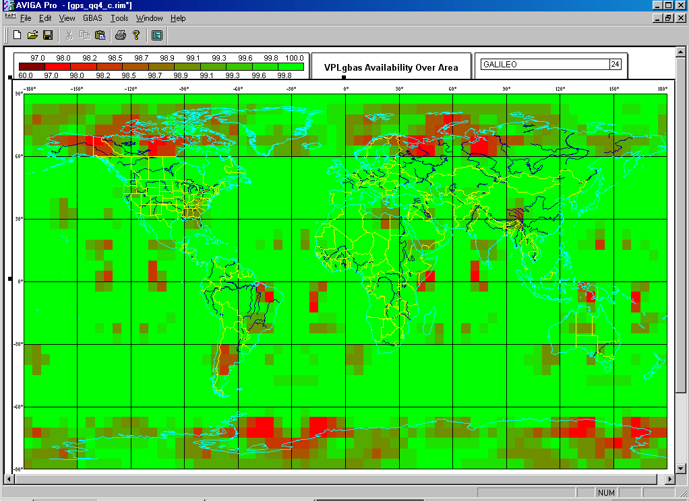
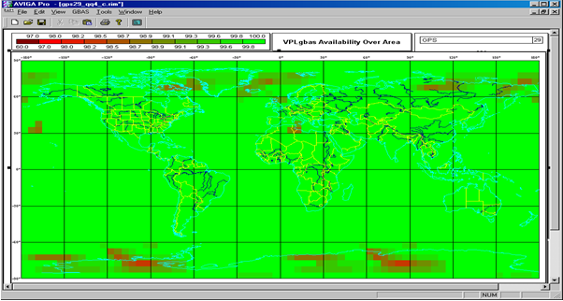
Case Study - Result EUROPE GPS 24 Vs GPS 29
Effect of Redundancy, Power and Monitoring (Block III) Improvements)
GPS 24 Global Availability
GPS 29 Global Availability

Slide 21
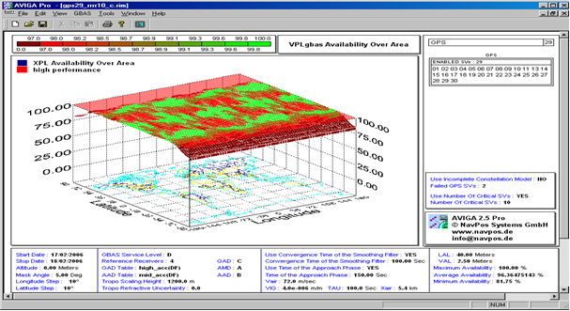
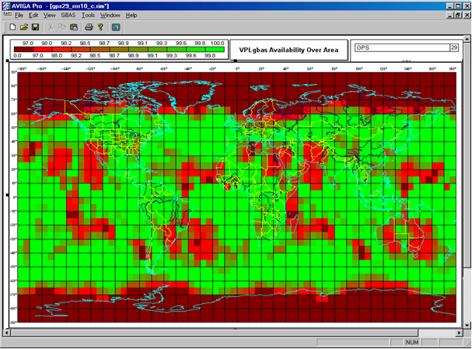
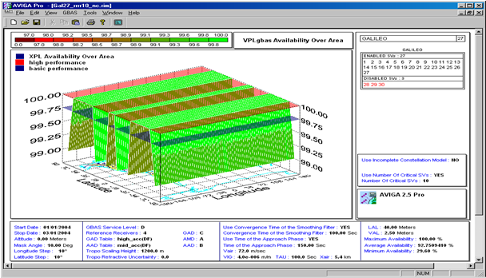
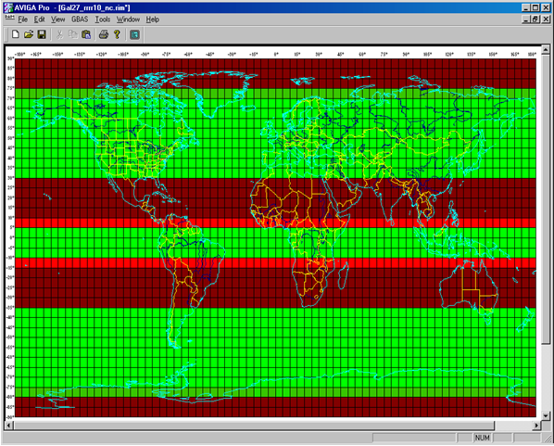
Case Study - Result EUROPE GPS and Galileo
Effect of Modulation BOC and Power
GPS 29 Availability – 3D
GPS 29 Availability – 2D
Galileo 27 availability- 3D
Galileo 27 availability- 2D

Slide 22
Final Findings and Recommendations
  Galileo 27 constellation was able to meet the aeronautical availability Target of 99,75% over Europe with the given input parameters of the best GBAS configuration of CB-DF and for VAL= 2,5M, But GPS 29 was not able to meet these requirements.
  GPS 29 constellation shows that green spots of good availability are continuously moving and cannot always be assured over a certain geographic area like a specific airport for example.
  Galileo (IOC ) theoretical Constellation shows promising behave of the guaranteed good availability over a fixed areas of the globe, these areas look like stripes belts bounding the earth over a certain latitudes depending on the input parameters.
  Both GPS 29 and Galileo performance meet CAT I requirements in Hungary and Europe

Slide 23
Thank you for paying attention
Any Questions ?

